Slide 1
7 Algorithm design and problem-solving
Decomposition overview

Slide 2
Decomposition in daily life
Decomposition means breaking a complex problem down into smaller, more manageable parts.
Dealing with many different stages of a large problem at once is much more difficult than breaking it down into a number of smaller problems and solving them one at a time.
Big problem
Main component 1
Main component 2
Sub-problem 1
Sub-problem 2
Sub-problem 3
Sub-problem 4

Slide 3

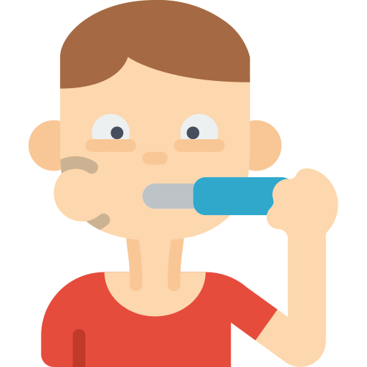


Decomposition in daily life
You do many tasks on a daily basis:
Getting up in the morning
Brushing your teeth
Travelling to school
Doing your homework
These are all complex tasks with many steps involved, but you break them down and execute them without even thinking about it.

Slide 4

Decomposition in daily life
Even an everyday problem like crossing the road can be broken down into sub-problems.
Cross a road
Stop before crossing.
Look left and right.
Is the road clear?
If not, press the button.
Wait for the lights to turn red.
Cross the road when it’s safe.

Slide 5
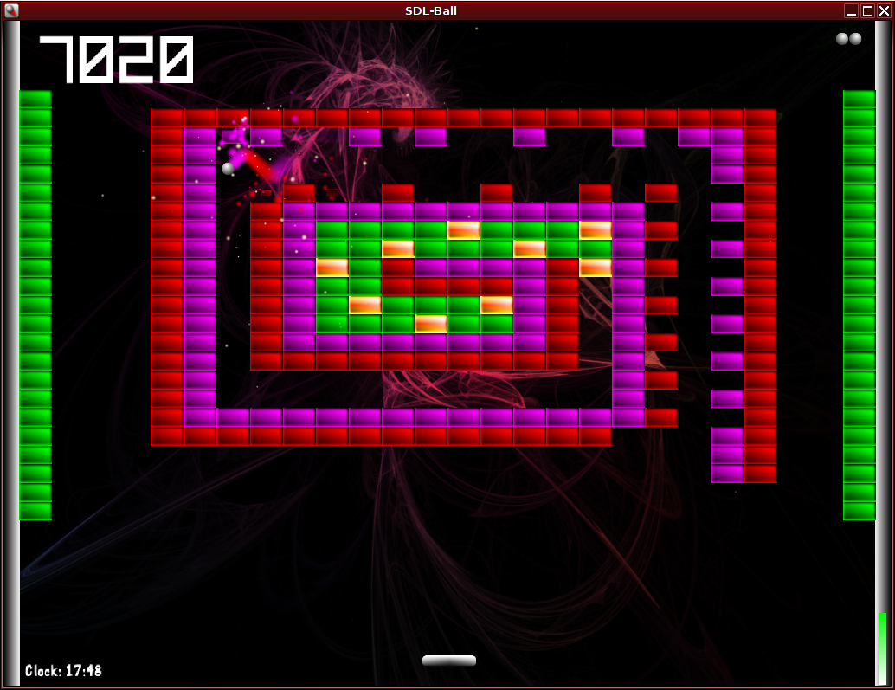
Decomposition
Breakout clone
How the game works:
The player controls the paddle at the bottom of the screen. The paddle can be moved left and right.
When the ball bounces off the paddle, it is redirected towards the blocks above. If the ball hits a block, that block is removed.
The aim is to remove all the blocks. If the ball leaves the bottom of the screen, the player loses a life.
How could we use decomposition to help us break down the process of programming this game?

Slide 6
Decomposition
Breakout clone
Breaking down the problem:
Display the paddle on-screen.

Slide 7
Decomposition
Breakout clone
Breaking down the problem:
Display the paddle on-screen.
Allow it to move left and right.

Slide 8
Decomposition
Breakout clone
Breaking down the problem:
Display the paddle on-screen.
Allow it to move left and right.
Prevent it from moving off the left or right edge of the screen.

Slide 9
Decomposition
Breakout clone
Breaking down the problem:
Display the paddle on-screen.
Allow it to move left and right.
Prevent it from moving off the left or right edge of the screen.
Display the ball on-screen.

Slide 10
Decomposition
Breakout clone
Breaking down the problem:
Display the paddle on-screen.
Allow it to move left and right.
Prevent it from moving off the left or right edge of the screen.
Display the ball on-screen.
Program its movement.

Slide 11
Decomposition
Breakout clone
Breaking down the problem:
Display the paddle on-screen.
Allow it to move left and right.
Prevent it from moving off the left or right edge of the screen.
Display the ball on-screen.
Program its movement.
Display the blocks on-screen.

Slide 12
Decomposition
Breakout clone
Breaking down the problem:
Display the paddle on-screen.
Allow it to move left and right.
Prevent it from moving off the left or right edge of the screen.
Display the ball on-screen.
Program its movement.
Display the blocks on-screen.
Program collision detection.

Slide 13

Decomposition
Breakout clone
Breaking down the problem:
Display the paddle on-screen.
Allow it to move left and right.
Prevent it from moving off the left or right edge of the screen.
Display the ball on-screen.
Program its movement.
Display the blocks on-screen.
Program collision detection.
Implement winning and losing.

Slide 14
Decomposition
Breakout clone
Breaking down the problem:
Display the paddle on-screen.
Allow it to move left and right.
Prevent it from moving off the left or right edge of the screen.
Display the ball on-screen.
Program its movement.
Display the blocks on-screen.
Program collision detection.
Implement winning and losing.
Add extras: sounds, effects, graphics, background, etc.

Slide 15

Decomposition
Decomposition means breaking a complex problem down into smaller, more manageable parts.
Advantages of problem decomposition
Makes problems easier to solve.
Different people can work on different parts of a problem at the same time, reducing development time.
Program components developed in one program can easily be used in other programs.

Slide 16


